Slide 1
US Income Inequality: Causes, Consequences, and Cures
Dr. Rick Schiming
Professor Emeritus
Department of Economics
Minnesota State University, Mankato

Slide 2
If a free society cannot help the many who are poor, it cannot save the few who are rich.
John F. Kennedy

Slide 3
Let me tell you about the very rich. They are different from you and me.
F. Scott Fitzgerald

Slide 11
US Income Distribution is More Unequal than:
Iran
Russia
China
India
Egypt
Greece
Pakistan

Slide 12
Lessons for US Income Inequality
It is real
It hurts
It can be reduced

Slide 13
Bottom 20% of US Households
Have 3% of all US income
Earns less than $21,000 per year
Average income = $12,000 per year

Slide 14
Second Lowest 20% of US Households
Has 8% of all US income
Earns between $21,000 and $40,000 per year
Average income = $31,000 per year

Slide 15
Middle 20% of US Households
Has 14% of all US income
Earns between $40,000 and $64,000 per year
Average income = $52,000 per year

Slide 16
Second Highest 20% of US Households
Has 23% of all US income
Earns between $64,000 and $104,000 per year
Average income = $83,000 per year

Slide 17
Highest 20% of US Households
Has 51% of all US income
Earns more than $104,000 per year
Average income of $185,000 per year

Slide 18
Curable Causes
Decline of Unions
Stagnant Minimum Wage
More Affordable Access to Education
Taxes
Rigged Financial System
Ongoing Discrimination

Slide 19
Bottom 20%
18% had at least one person working full-time
12% had college degree
54% were in bottom quintile 10 years earlier
Single parent or single person = 83%
80% of average income for child care

Slide 20
Second Lowest 20%
44% had at least one person working full-time
18% had college degree
25% were in bottom quintile 10 years earlier
Single parent or single person = 64%
31% of average income for child care

Slide 21
Middle 20%
61% had at least one person working full-time
33% had college degree
9% were in bottom quintile 10 years earlier
Single parent or single person = 52%
18% of average income for child care

Slide 22
Second Highest 20%
72% had at least one person working full-time
33% had college degree
8% were in bottom quintile 10 years earlier
Single person or single parent = 30%
11% of average income for child care

Slide 23
Highest 20%
79% had at least one person working full-time
65% had college degree
4% were in bottom quintile 10 years earlier
Single parent or single person = 23%
5% of income for average child care

Slide 26
Cure 1: Increase Unionization

Slide 27
Increased Unionization
If the private sector had the same percentage of union membership now as in 1979, non-union workers would have earned $2,700 more in 2013 and men without high school diploma would have earned $3,100 more in 2013.

Slide 28
Cure 2: Higher Minimum Wage

Slide 30
Higher Minimum Wage
Each $1 increase in the minimum wage would increase overall life expectancy by 15 days per person, a total of 12 million life years for total US population.

Slide 31
Cure 3: Increased Access to Affordable Education and Training

Slide 32
Increased Access to Education and Training
US spends 3/100 of 1% of its GDP on worker training programs while Germany spends 7x as much, France 12x as much, and Denmark 18x as much.

Slide 33
Cure 4: Fairer Tax System

Slide 35
Maryland State and Local Taxes

Slide 36
Cure 5: Fairer Financial System

Slide 37
Fairer Financial System
By one estimate, the US financial system imposes excess costs of $5,000 per year per household.

Slide 38
Cure 6: Reduce Discrimination in Hiring and Promotion

Slide 39
Discrimination

Slide 41
Discrimination
One estimate is that 60% of an individual’s income is determined the day one is born.

Slide 42
Percentage of Total Political Contributions by Top 1% of the Top 1%

Slide 43
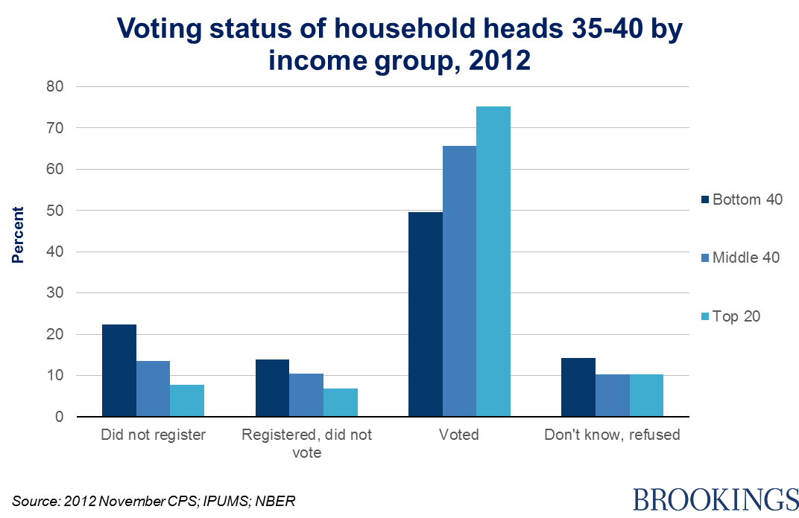

Slide 45
Voter Turnout in Last Presidential Campaign
Denmark 80%
Norway 78%
Finland 71%
Canada 62%
Sweden 83%
Germany 66%
US 54%

